Slide 1
Thompson Sampling overview
Shipra Agrawal

Slide 2
Thompson Sampling [Thompson 1933]
A simple heuristic based on Bayesian philosophy of learning

Slide 3
Simple Bayesian heuristic
Aim is to quickly identify the Bernoulli arm with highest mean
Need to learn the unknown mean for each arm to sufficient accuracy
Heuristic:
For every arm, maintain a belief about where the mean is in [0,1]
Initially you are very unsure about where the mean is, start with uniform
Shift the distribution to left if you observe a 0, right if you observe a 1
Play the arm with highest probability of “being the best arm”
This is Thompson Sampling!

Slide 4
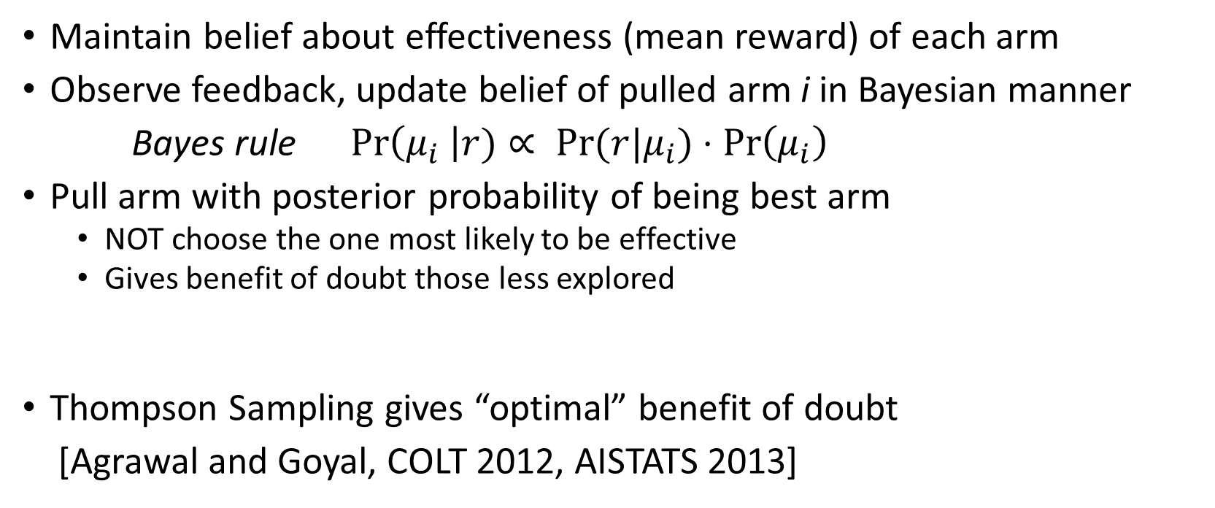
Thompson Sampling [Thompson, 1933]
Maintain belief about effectiveness (mean reward) of each arm
Observe feedback, update belief of pulled arm i in Bayesian manner
Bayes rule ${Pr\left(μ_{i} \right|r)∝ Pr⁡(r|μ}_{i})⋅\operatorname{Pr}\left(μ_{i}\right)$
Pull arm with posterior probability of being best arm
NOT choose the one most likely to be effective
Gives benefit of doubt those less explored
Thompson Sampling gives “optimal” benefit of doubt
[Agrawal and Goyal, COLT 2012, AISTATS 2013]
Notes:
If a customer likes the product update the belief to be more favorable for the product

Slide 5
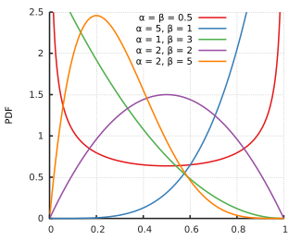

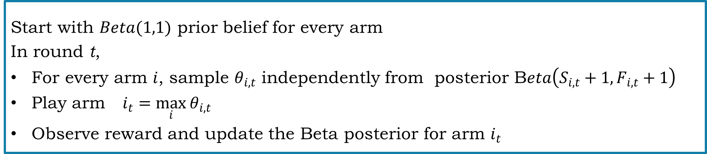
Bernoulli rewards, Beta priors
Uniform distribution $Beta(1,1)$
$Beta\left(α,β\right)$prior $⇒$ Posterior
$Beta\left(α+1,β\right)$ if you observe 1
$Beta\left(α,β+1\right)$ if you observe 0
Start with $Beta(1,1)$ prior belief for every arm
In round t,
For every arm $i$, sample $θ_{i,t}$ independently from posterior B$eta\left(S_{i,t}+1,F_{i,t}+1\right)$
Play arm $i_{t}=\max_{i}{θ_{i,t}}$
Observe reward and update the Beta posterior for arm $i_{t}$

Slide 6
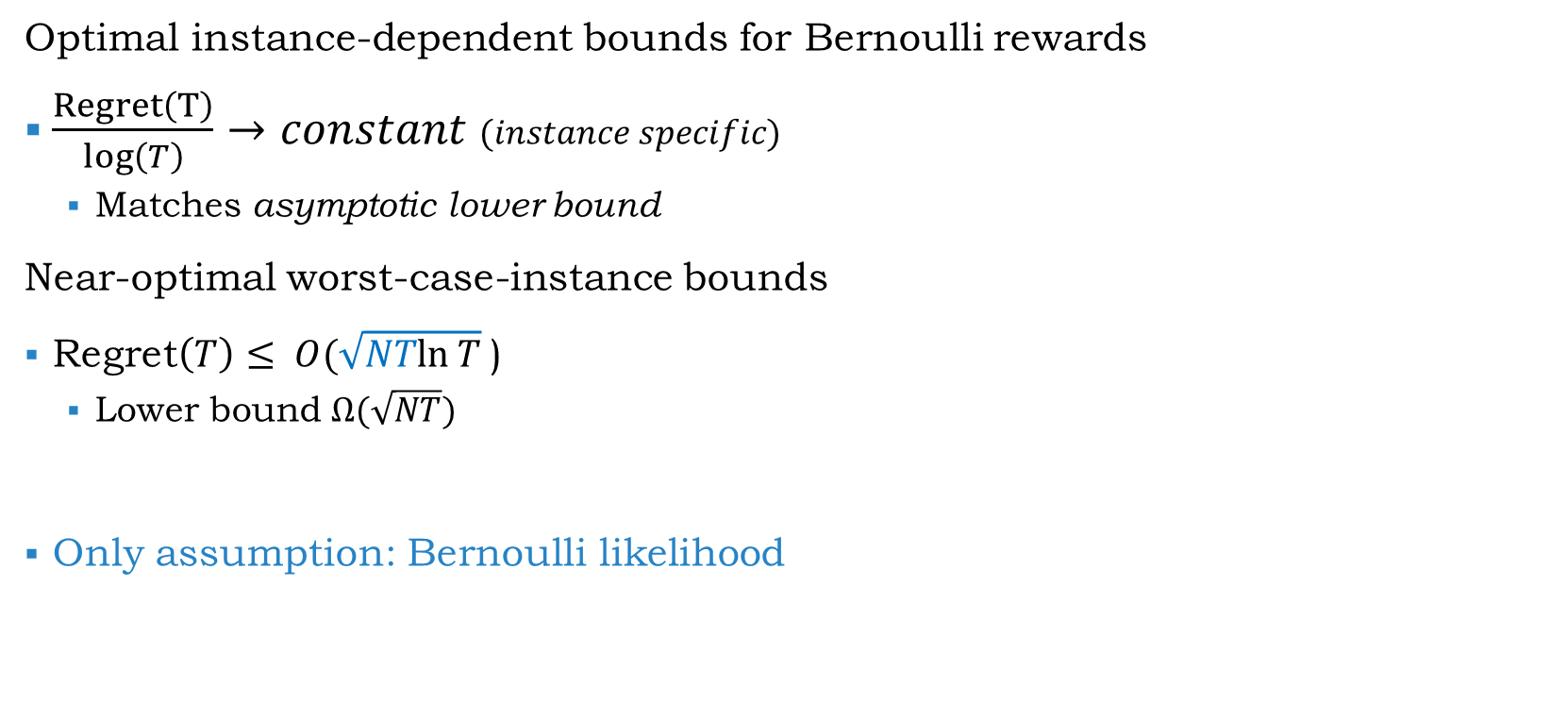
Regret bounds [A. Goyal, COLT 2012, AISTATS 2013]
Optimal instance-dependent bounds for Bernoulli rewards
$\frac{Regret\left(T\right)}{\log\left(T\right)}→constant$ $(instance specific)$
Matches asymptotic lower bound
Near-optimal worst-case-instance bounds
Regret$\left(T\right)≤ O(\sqrt{NTln T}$)
Lower bound $Ω(\sqrt{NT})$
Only assumption: Bernoulli likelihood
Notes:
Simple extension to arbitrary distribution with [0,1] support
for any algorithm [Lai Robbins 1985]
The popular UCB algorithm achieves this only after careful tuning [Bayes-UCB Kaufmann et al. 2012]

Slide 7

Thompson Sampling with Gaussian Priors
Suppose reward for arm $i$ is i.i.d. $N(μ_{i},1)$
Starting prior N(0,1)
Gaussian Prior, Gaussian likelihood $→$Gaussian posterior $N({\hat{μ}}_{i,t}, \frac{1}{n_{i,t}+1})$
${\hat{μ}}_{i,t}$is empirical mean of $n_{i,t}$ observations for arm $i$
Algorithm
Sample$θ_{i, t}$ from posterior $N\left({\hat{μ}}_{i,t}, \frac{1}{n_{i,t}+1}\right)$ for arm $i$
Play arm $I_{t} = arg⁡\max_{i}{θ_{i,t}}$
Observe reward, update empirical mean for arm $i_{t}$
Now apply this algorithm for any reward distribution!

Slide 8
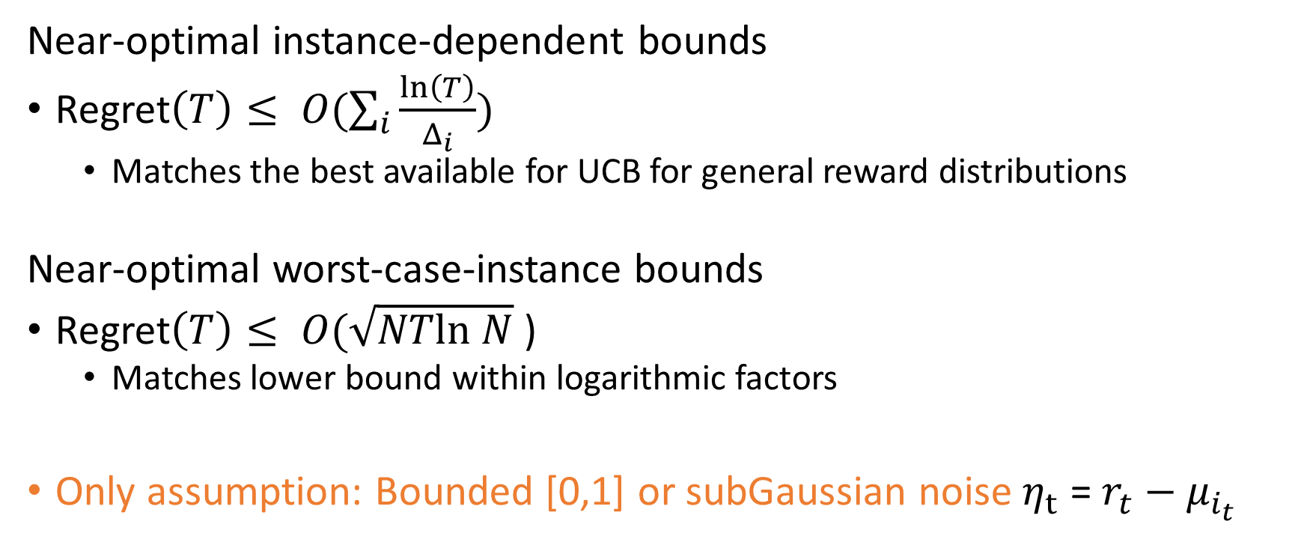
Regret bounds [A., Goyal, AISTATS 2013]
Near-optimal instance-dependent bounds
Regret$\left(T\right)≤ O(\sum_{i}{\frac{ln\left(T\right)}{Δ_{i}}})$
Matches the best available for UCB for general reward distributions
Near-optimal worst-case-instance bounds
Regret$\left(T\right)≤ O(\sqrt{NTln N}$)
Matches lower bound within logarithmic factors
Only assumption: Bounded [0,1] or subGaussian noise $η_{t}$ = $r_{t}−μ_{i_{t}}$

Slide 9
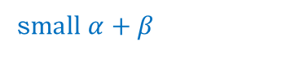

Why does it work?
The Bayesian approach takes into account the level of uncertainty about the means.
Higher uncertainty ensures that an less explored arm is pulled
The uncertainty reduces as the arm is explored more and more
Large number of pulls (large $α+β$)
s$mall α+β$
http://eurekastatistics.com/beta-distribution-pdf-grapher/

Slide 10

Why does it work? Two arms example
Two arms, $μ_{1}≥μ_{2}$, $Δ=μ_{1}−μ_{2}$
Every time arm 2 is pulled, $Δ$ regret
Bound the number of pulls of arm 2 by $\frac{log\left(T\right)}{Δ^{2}}$ to get $\frac{log\left(T\right)}{Δ}$ regret bound

Slide 11






Easy situation
After n=$O(\frac{ log\left(T\right)}{Δ^{2}})$ pulls of arm 2 and arm 1
Empirical means are well separated
Error $≤\sqrt{\frac{log⁡(T)}{n}}≤\frac{Δ}{4}$ whp
(Using Azuma Hoeffding inequality)
Beta Posteriors are well separated
standard deviation $≃\frac{1}{\sqrt{n}}≤\frac{Δ}{4}$
The two arms can be distinguished!
No more arm 2 pulls.
$$\hat{μ_{2}}$$
$$\hat{μ_{1}}$$
$$μ_{2}$$
$$μ_{1}$$
$$Δ$$
Notes:
How to achieve this number of bad pulls without knowing T or $Δ$?

Slide 12

Easy situation
If arm 2 is pulled less than n=$O(\frac{ log\left(T\right)}{Δ^{2}})$ times?
Regret is at most $nΔ=\frac{ log\left(T\right)}{Δ}$

Slide 13











Difficult situation
At least $\frac{ log\left(T\right)}{Δ^{2}}$ pulls of arm 2, but few pulls of arm 1
$$μ_{2}$$
$$\hat{μ_{1}}$$
$$μ_{2}$$
$$\hat{μ_{2}}$$
$$\hat{μ_{1}}$$
$$μ_{1}$$
$$\hat{μ_{2}}$$
$$μ_{1}$$
$$Δ$$
$$Δ$$

Slide 14
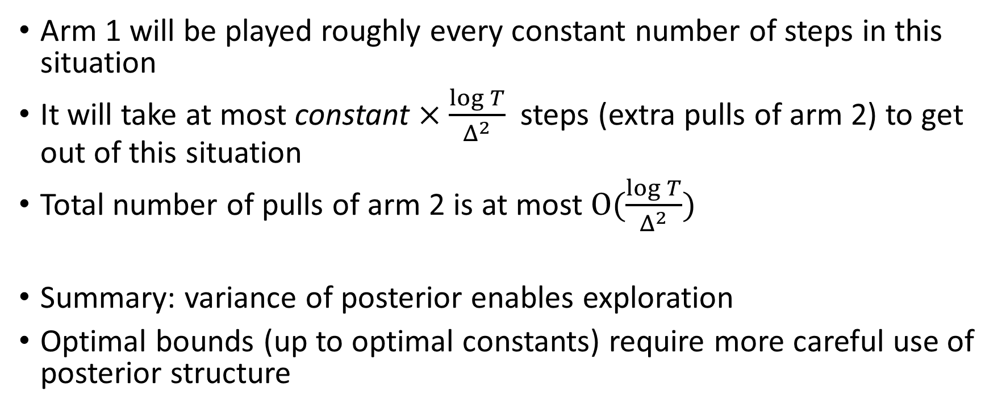
Main insight
Arm 1 will be played roughly every constant number of steps in this situation
It will take at most constant $×\frac{\log{T}}{Δ^{2}}$ steps (extra pulls of arm 2) to get out of this situation
Total number of pulls of arm 2 is at most $O(\frac{\log{T}}{Δ^{2}})$
Summary: variance of posterior enables exploration
Optimal bounds (up to optimal constants) require more careful use of posterior structure
Notes:
Look back at the figure to explain this insight (since number of pulls is low, variance of posterior is high so frequently you will get something above mean -- high value samples) High variance of posterior is enabling exploration of less explored arm. Once there are enough samples variance is low, but then the empirical mean is close to actual and arms are well separated.

